Slide 1
Build your own copilot with Teams AI Library and .NET
Edward Pollack
Microsoft Data Platform MVP

Slide 2
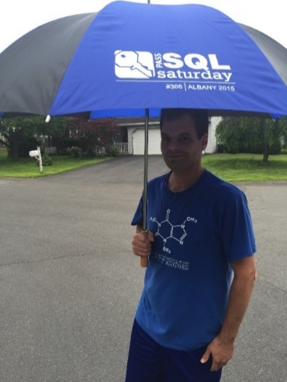




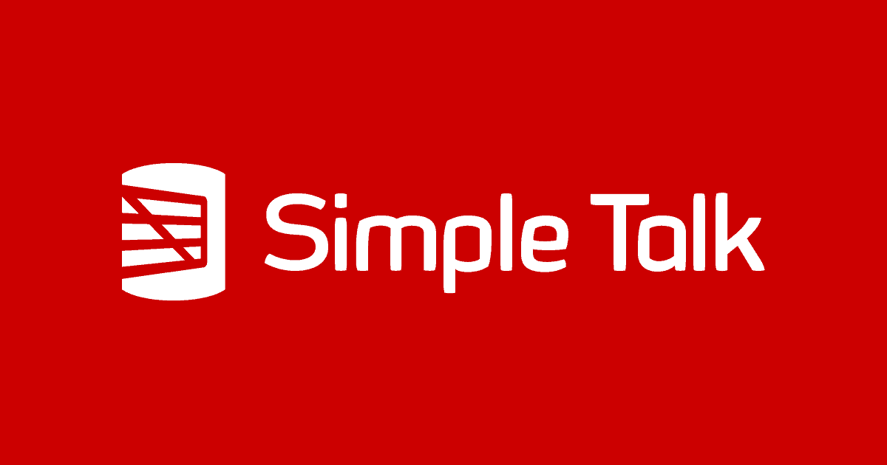

Ed Pollack
Microsoft Data Platform MVP
Published author of:
Dynamic SQL: Applications, Performance, and Security, 2nd Edition
Analytics Optimization with Columnstore Indexes in SQL Server
Expert Performance Indexing in SQL Server, 4th Edition
Published in Expert T-SQL Functions in SQL Server, 3rd Edition
Author on Simple Talk.
Organizes:
SQL Saturday Albany 2024
SQL Saturday New York City (Tentatively: May 10^{th)}
Future Data Driven
Capital Area SQL Server User Group
Speaker at many data events
Find me on: LinkedIn

Slide 3
Agenda
01
02
03
Copilot stack
Teams AI Library
Teams Toolkit

Slide 4



Copilot extensions
Extend Microsoft Copilot
Build your own copilot
Copilot
Your copilot
Low & pro-code
Copilot
Studio
Visual Studio
Code
Notes:
So to get us started, let’s back up a step, and talk about the complementary platform pillars for building Copilots, from low code with Copilot Studio to coding environments like Visual Studio and Visual Studio Code.

Slide 5
Copilot extensions
Ground responses
Bring actions
Focus user experiences
Connectors
Plugins
Your copilots
Your business knowledge
Your apps
Your business knowledge
Your workflows
Your apps
Your automation
Your workflows
Your automation
Notes:
First, you have the choice to extend Microsoft’s Copilot. I think about these options as “bringing your app to Microsoft’s AI.” Connectors and Plugins fit this category well. But of course, you also have the option of building your own copilot, which is the right side of this slide.

Slide 6
Copilot extensions
Ground responses
Bring actions
Focus user experiences
Connectors
Plugins
Your copilots
Your business knowledge
Your apps
Your business knowledge
Your workflows
Your apps
Your automation
Your workflows
Your automation
Notes:
I think of this as “bringing AI to your app”. This right hand side is what we’re going to focus on today, with Teams Toolkit for Visual Studio.

Slide 7

Building your copilot
Teams
Teams AI Library
+
Bot Framework
LLM
Notes:
So, let’s start by breaking down what a custom copilot is.

Slide 8
Building your copilot
Teams
Teams AI Library
+
Bot Framework
LLM
Model:
Orchestrators, foundational models, and data
Notes:
At its base, a copilot uses an orchestrator that sits on top of a foundational model. This is the AI brain of your copilot. Coming up, we’re going to show you a few tools for developing on these models and adding your data to suit your needs, like Azure OpenAI Studio. But its important to note that you can use any large language model in your custom copilot.

Slide 9
Building your copilot
Teams
Conversational Interface:
Instructions, Actions, Handlers, Triggers, and Intent Detection
Teams AI Library
+
Bot Framework
LLM
Model:
Orchestrators, foundational models, and data
Notes:
But models and data alone are just one level of the stack. To start to build a conversational interface, you’ll need to add prompt instructions, actions with your business logic, event handlers, triggers and intent detection. Late last year, we launched a new set of tools that modernized Teams bots. We called this the Teams AI library. It was built on Microsoft’s bot framework, and this was the foundational groundwork for a custom copilot.

Slide 10
Building your copilot
Teams
Conversational Interface:
Instructions, Actions, Handlers, Triggers, and Intent Detection
Teams AI Library
+
Bot Framework
LLM
Model:
Orchestrators, foundational models, and data
.NET, JS, Python
Notes:
…and that AI Library is generally available in .NET, JavaScript, and, now, Python.

Slide 11
Building your copilot
UX:
Streaming, Citations, Feedback Looping, and more
Teams
Conversational Interface:
Instructions, Actions, Handlers, Triggers, and Intent Detection
Teams AI Library
+
Bot Framework
LLM
Model:
Orchestrators, foundational models, and data
.NET, JS, Python
Notes:
Finally, your models, data, and conversational interface all have to run in Microsoft 365. And we’ve totally modernized our chatbots to look and feel just like modern copilots in Teams. This means new features like streaming, citations, feedback loops, AI labels, and more. Ayca will demo some of that in a minute.

Slide 12

Before
Bots use a primitive list of declared commands
No understanding of app skills
Hard to utilize user intention
Notes:
In Teams, we've had chatbot support right from the start, but building bots that felt natural to interact was always a challenge.
Most bots relied on a limited list of declared commands, which felt primitive and restrictive, and users had to understand these to interact with your app’s skills. - NLP was incredibly complex and expensive.

Slide 13
With the Teams AI Library
Bots are evolving to be conversational copilots
Apps can register skills
Extract user intent from natural language
Notes:
You can now use the Teams AI Library to address these challenges and introduce the way to build copilots for M365.
With the AI Library, your copilots can use language models to facilitate more natural conversational interactions with users, guiding that conversation into your apps skills.
This means you can focus on writing your business logic, and allow Teams to handle the complexities of conversational bot development, so you, as developers, can easily extract and utilize user intent within your apps.
Overall, this means the Teams AI Library helps you to create more intelligent and personalized experiences for your users.

Slide 14

Conversational and contextual
Truly conversational Teams apps built with purpose to leverage app skills
@bot make a task for Babak from this
M365 interface to LLMs
Built-in natural language processing, akin to ChatCopilot Extension, with prompt engineering and moderation
Copilot built with the Teams AI Library
LLM
Microsoft 365
Planning engine that guides conversation to extract intents and map to app actions
Here’s the new task for Babak, everything look good
LLM modularity – developers can use any LLM they choose
Notes:
The AI Library is a M365 interface to Large Language Models. Using techniques like prompt engineering you can add copilot like conversational experiences and built-in safety features, like moderation, can help make your copilot respond in an appropriate manner.
The library includes a planning engine that lets the model identify user intent and then maps that intent to actions that you implement.
There’s built-in support for both OpenAI and Azure OpenAI models, but you can easily add support for any model you choose…

Slide 15
Get started in 4 simple steps
Create AI components
1
Create application object
2
Add prompts
3
Add actions
4
Notes:
There’s four steps to get started with the AI Library:
1. You’ll start by scaffolding out the necessary AI components for your copilot. This will include importing the library into your project and configuring a few component settings.
2. Next, you’ll create an Application object that represents your copilot within the M365 environment. This object will be used to handle incoming messages, process user input, and handle AI triggered actions.
3. Then you’ll create a prompt for your copilot. Prompts define the AI’s personality, it’s behavior, and inform the AI of the actions your copilot can perform.
4. Finally, you’ll implement your copilots actions – this is your business logic. Actions are the primary way your code interfaces with the AI components and the model. Actions can call external API’s, process data, or just generate appropriate responses.

Slide 16
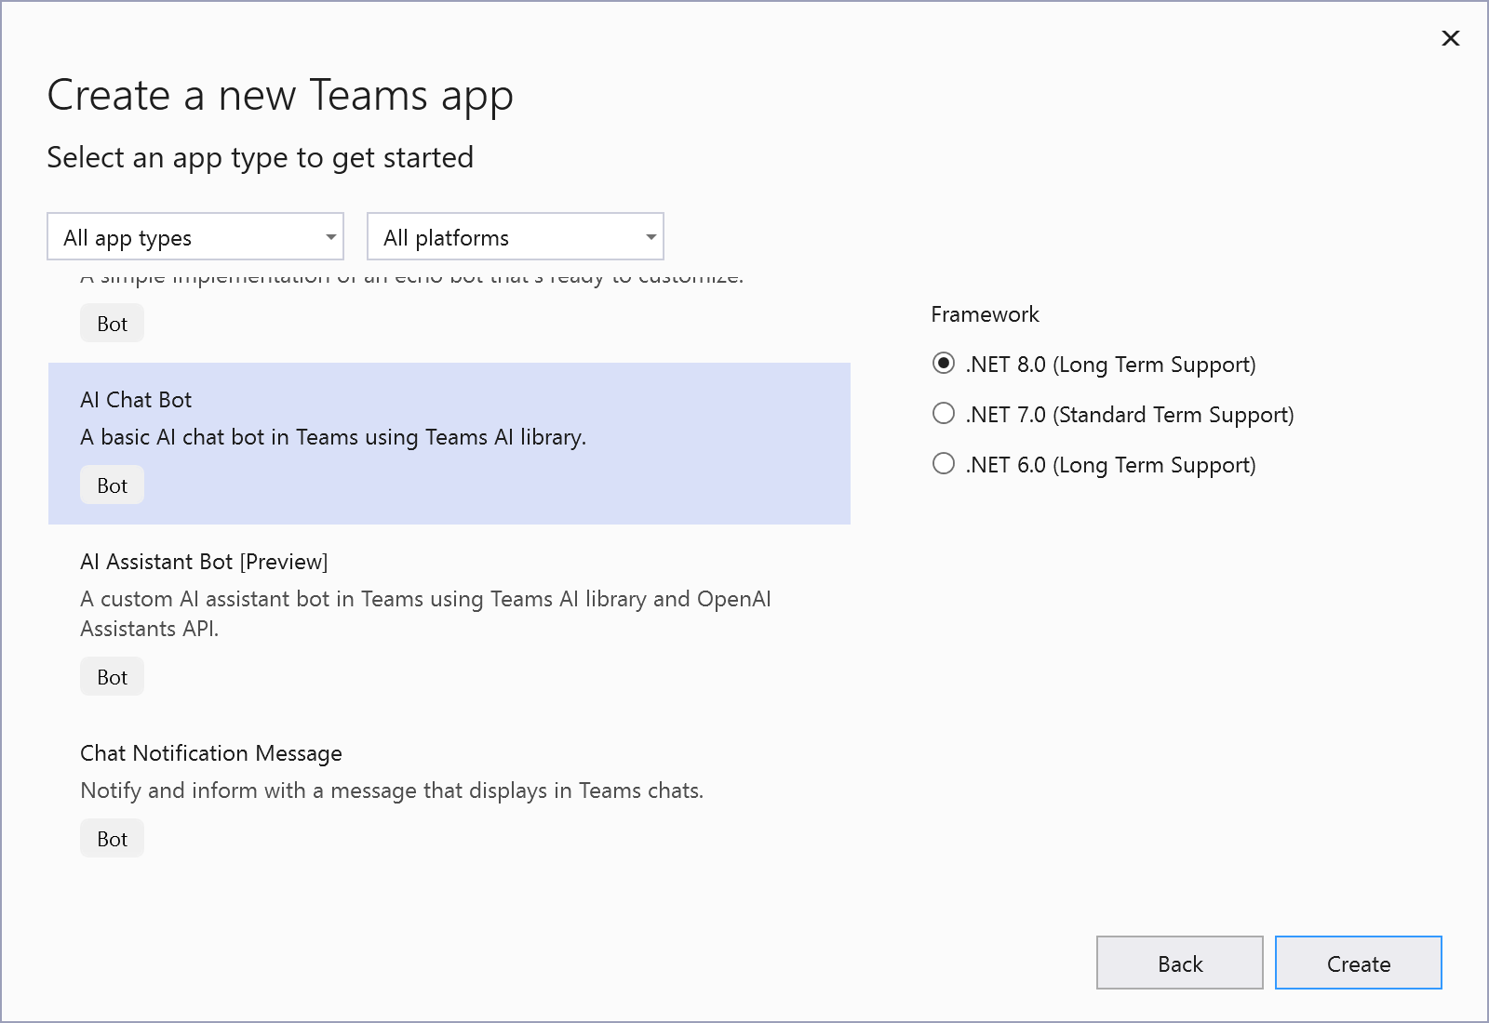
Teams Toolkit for Visual Studio
Developer tools for building custom copilots and apps for Teams, Outlook, and the M365 app.
Notes:
To make it simpler to get started, you can use Teams Toolkit for Visual Studio. It’s a set of templates and tools to make building custom copilots and apps for Teams and across Microsoft 365 easier. It includes support for automating a lot of the setup, debugging, and provisioning to run your experiences in Teams. It includes project templates that use Teams AI Library to help you get started. Now I will hand it over to Ayca so she can show you exactly what Im talking about in Visual Studio.

Slide 17
DEMO

Slide 18

Powered by AI Kit
Streaming UX
AI labels
Citations
Feedback loop
Copilot handoffs
Bot and Stage 🤝
Notes:
We’re launching a ton of new UX improvements for custom copilots in Teams. We’re calling this the “Powered by AI” kit, and all of it is available now in preview. This set of UX features makes your custom copilot look and feel like a Microsoft Copilot.

Slide 19
Building your copilot
UX:
Streaming, Citations, Feedback Looping, and more
M365
Conversational Interface:
Instructions, Actions, Handlers, Triggers, and Intent Detection
Teams AI Library
Bot Framework
LLM
Model:
Orchestrators, foundational models, and data
.NET, JS, Python
Notes:
We broke apart each component of the copilot tech stack, from foundational models, to the Teams AI Library, to the huge array of new UX features on Teams. All of that together is a best-in-class solution for building and deploying your own custom copilot in Microsoft 365.

Slide 20
aka.ms/TryTeamsToolkit
Try it today!
With Teams AI Library
Notes:
If you want to get started, Try Teams Toolkit and the AI Library today.

Slide 21
Teams Toolkit repo: aka.ms/ttk
AI Library GitHub repo: aka.ms/teams-ai-repo
Powered by AI UX: aka.ms/powered-by-ai
Adaptive Card starter pack: aka.ms/teams-card-starters
References
Notes:
And for more, I’ll pause here to let you take a picture and visit these resources. In particular, we have three hands on labs where you can do your best John Miller impression and build your own copilot from scratch.

Slide 22
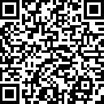
.NET Conf: Focus on AI
Learn more
aka.ms/dotnetFocusAI/Collection

